Slide 2
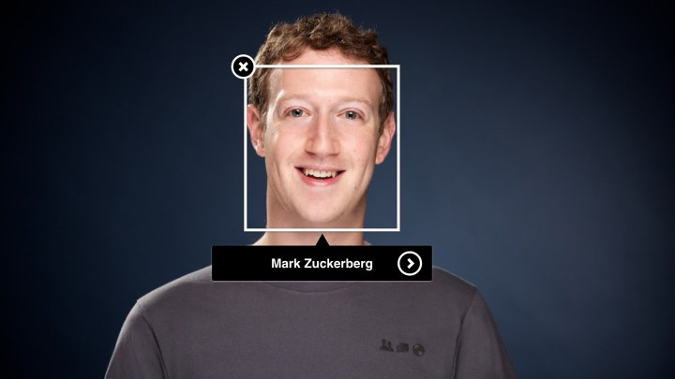
Software Engineering
Assignment
Project on
“face detection of lost children”
Submitted by,
Team leader : Vaibhav K
Team members : Uday
Vinay
Rakesh
Submitted to,
Dr. Sreeja Rajesh
Assistant Professor
Department of Information Science

Slide 3
Problem Statement
As there are many relevant kidnapping cases are increasing day by day and there is no means to know the updates of the kids are that been lost from many days. There should be a solution for this problem faced by the world.
According to recent data, more than 47,000 children were reported missing in India, with 71% of them being girls. Another source estimates that around 96,000 children go missing each year in India. This issue has been on the rise, and many of these cases are linked to human trafficking and child labor.

Slide 4
Face detection
Fresh updates
Device tracking
Features :

Slide 5
Face Detection
Algorithm
By using the photograph the public can find the matching children from the already stored data. The system will prompt the most matching cases after applying a face recognition algorithm to the uploaded image. Once the matching is done then the con-cerned person will get the details of the child.

Slide 6
Device tracking
The citizen interface of 'Track Child' system may be accessed through mobile devices. A citizen can access the portal through mobile devices to use 'specialized' light weight interfaces to 'report a missing'/ 'report a found' child or to search a missing/found child.
We are also connected with police stations for investigation for tracking of the lost kid.

Slide 7
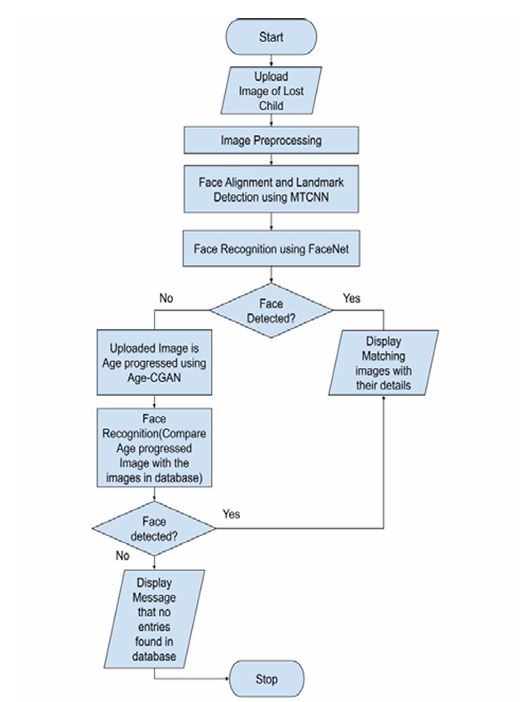
Flowchart :

Slide 8
Thank You

